Slide 1
GRAPH COLORING

Slide 2
Basic Concept
Let G be a graph and m be a given positive integer.
We want to discover if the nodes of G can be colored in such a way that no two adjacent nodes have the same color yet only m colors are used.
This is termed the m-colorability decision problem.
The m-colorability optimization problem asks for the smallest integer m for which the graph G can be colored.
This integer is referred to as the chromatic number of the graph.

Slide 3
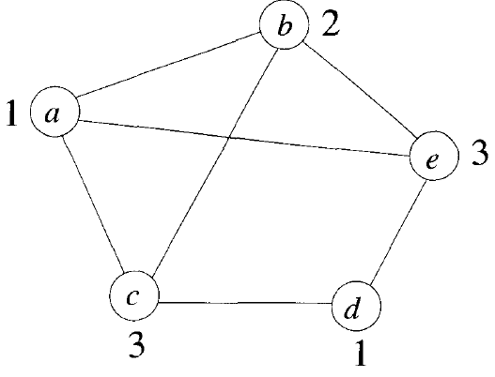
An example graph and its coloring

Slide 4
m-colorability decision problem
A famous special case of the m-colorability decision problem is the 4-color problem for planar graphs.
This problem asks the following question: given any map, can the regions be colored in such a way that no two adjacent regions have the same color yet only four colors are needed.
This map requires 4 colors. For many years it was known that 5 colors were sufficient to color any map, but no map had ever been found which required more than 4 colors.

Slide 5
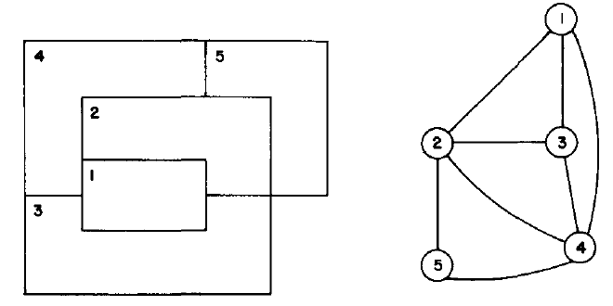
A map and its planer graph representation

Slide 6
Assumption for Algorithm
Suppose we represent a graph by its adjacency matrix G[l:n, l:n], where G(i, j) = 1 if (i, j) is an edge of G and otherwise G(i,j) = 0 otherwise.
The colors will be represented by the integers 1, 2, ... , m and the solutions will be given by the n-tuple (X₁, ... , X_{n}) where X_{i} is the color of node i.
Procedure MCOLORING is begun by first assigning the graph to its adjacency matrix, setting the array X to zero, and then invoking the statement call MCOLORING(1).
Procedure NEXTVALUE produces the possible colors for X(k) after X(1) through X(k – 1).

Slide 7
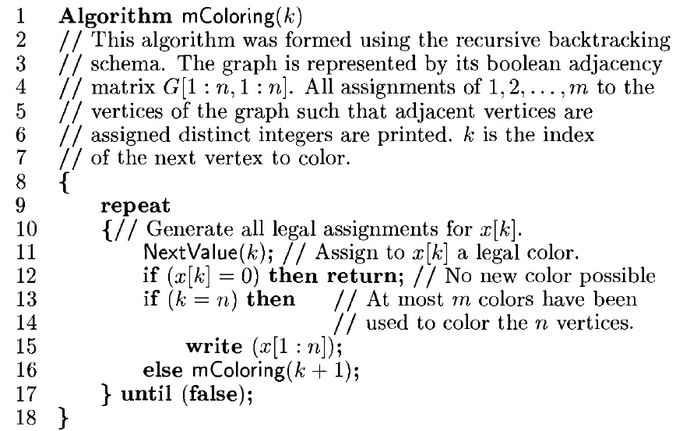

Slide 8
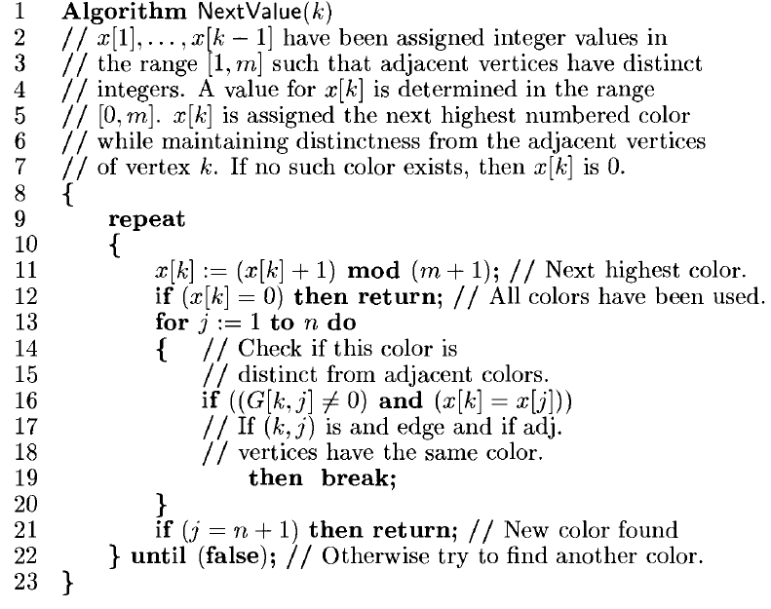

Slide 9

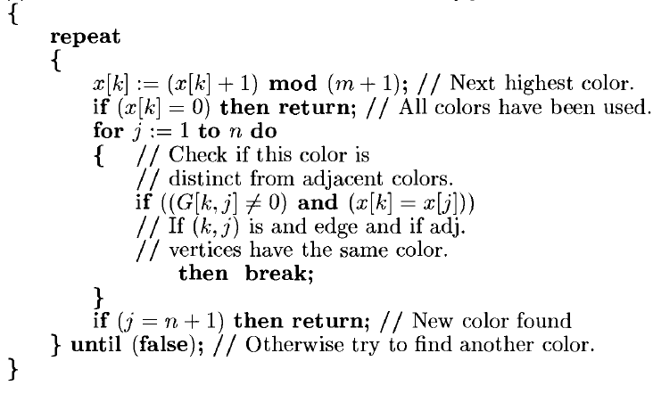
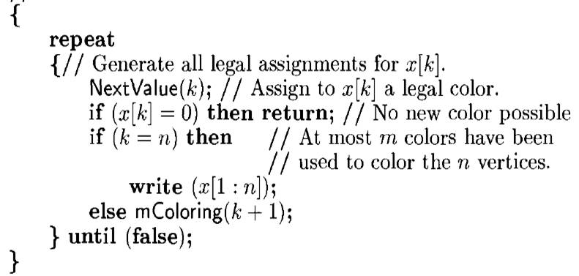
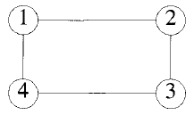

Slide 10
